Slide 1

Healthcare Dialysis
P_373 (group-6)

Slide 2
Team Members
Miss. Shrutika Ravindra Sarnobat
Mr. Yash Ajit Shinde
Mr. Deepak Narsingh Prajapati
Mr. Saurabh Santosh Shirsikar
Miss. Namrita Ashit Uchil
Ms. Tanushri Bholenath Mune

Slide 3
INTRODUCTION
Key performance indicators (KPIs) are analyzed in dialysis analysis in order to obtain insight into that specific data and make informed decisions in the dialysis industry.
The number of dialysis centers in the area, the number of patients in various summaries, the comparison of profit and non-profit organizations, the comparison of categories and their anticipated results, and the tracking of payment reduction rates are all included.
After these details are examined, healthcare institutions will be able to treat every patient more effectively. Through improved treatment infrastructure, dialysis patients will ultimately benefit from this optimization of the healthcare system.

Slide 4
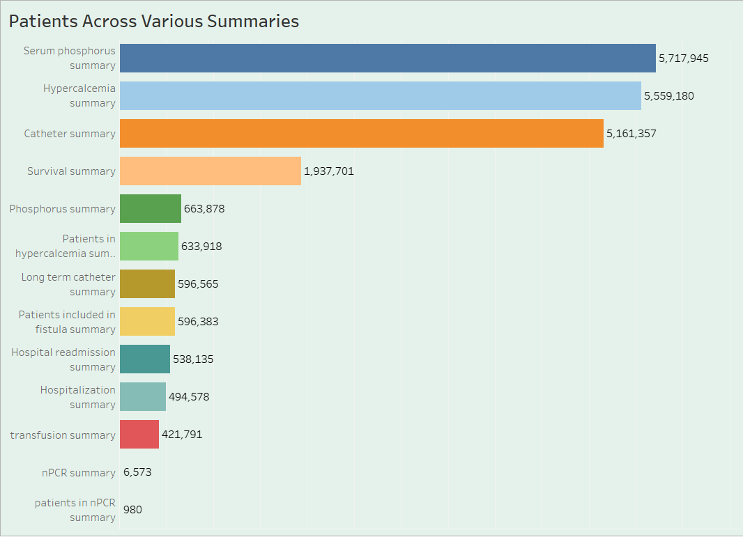
Number of Patients across various summaries
The most important thing to do is analyse patients in different summaries. This will allow us to precisely determine the number of people receiving dialysis in each category.
Analyzing patients in various summaries is the crucial thing to do, By doing this we can exactly know how many people are in which category of dialysis.
This KPI gives us information about how much demand there is for dialysis services. As soon as we receive the numbers, we can help the dialysis provider, who needs to concentrate more on improving their infrastructure.

Slide 5
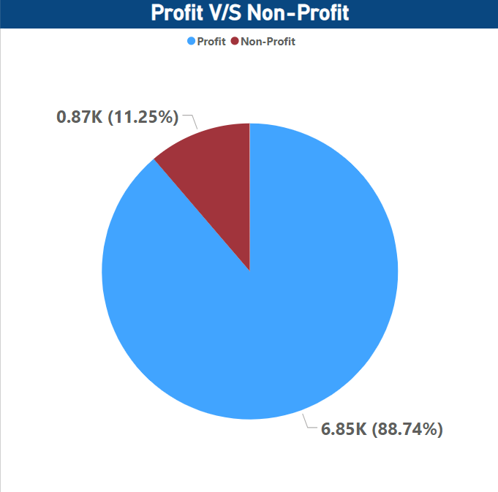
Profit vs Non-Profit Status
Comparing profit-and non-profit-based organizations is an essential component of the healthcare industry.
In order to comprehend the financial environment in the dialysis industry, this analysis makes use of important financial variables like revenue, costs, and return on investment.
Dialysis care providers can use this KPI to help distinguish between profit and non-profit organizations and to assist them make well-informed decisions about resource allocation and cost control.

Slide 6
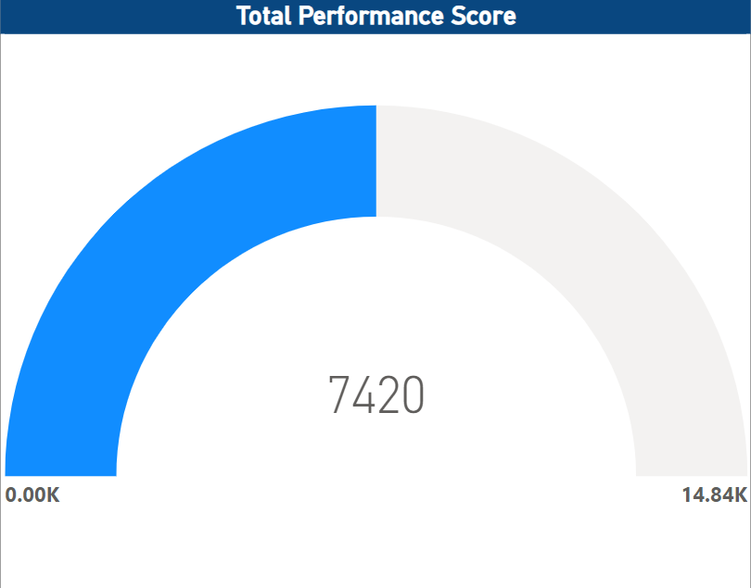
Total Performance Score as Non-Score
In dialysis healthcare analytics, an essential key performance indicator (KPI) is the evaluation of chain organizations using their entire performance score.
The total performance score takes into consideration a number of quality metrics, patient outcomes, and adherence to best practices, particularly for those who receive no score.
Healthcare providers are able to compare themselves to industry standards, identify areas for development, and improve the quality of care delivery across different chains by analyzing chain organizations based on their total performance score.

Slide 7
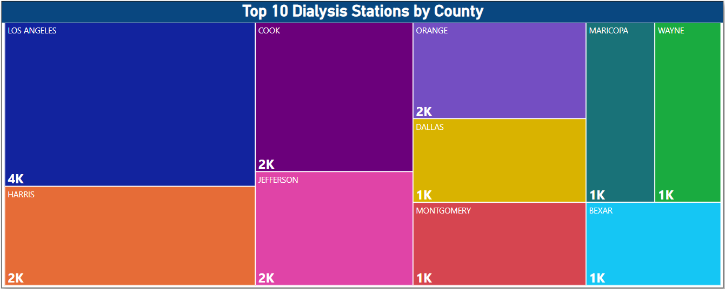
Top 10 Dialysis Stations by Country
One important performance metric for dialysis healthcare analytics is monitoring the data of dialysis stations.
It entails keeping an eye on the quantity, availability, utilization rates, and operational effectiveness of dialysis facilities.
Through statistical analysis, healthcare professionals can optimize resource allocation, pinpoint regions of underutilization or overcrowding, guarantee equitable access to dialysis services, and augment overall operational efficiency in the provision of care.

Slide 8
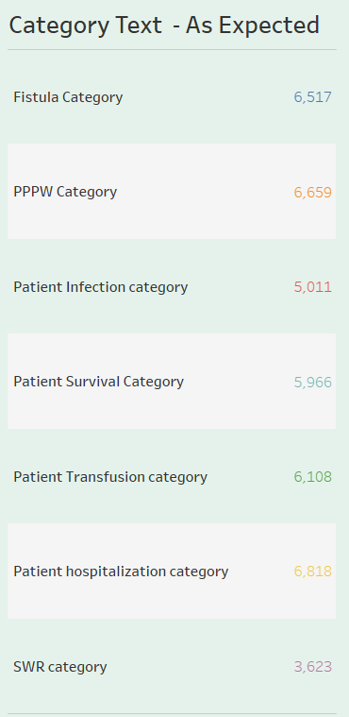
Category Text – As Expected
In dialysis healthcare analytics, examining the quantity of category texts—such as patient classifications or other relevant criteria—is a vital key performance indicator (KPI).
This procedure entails classifying patients according to particular standards and assessing their results.
Healthcare practitioners can evaluate the efficacy of various treatment regimens, spot trends, and customize care methods for particular patient categories by comparing these results with expectations. In the end, this may result in higher-quality care being given to dialysis patients.

Slide 9
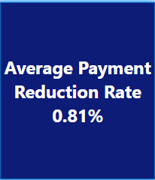
Average Payment Reduction Rate
In dialysis healthcare analytics, tracking the average payment decrease rate is an essential key performance indicator (KPI).
This KPI tracks how quickly dialysis service payments are decreased as a result of contractual agreements or revisions to reimbursement.
Healthcare providers can assess their financial performance, determine the causes of payment reductions, and create plans that reduce the impact on revenue while upholding standards of high-quality service by examining this KPI.

Slide 10
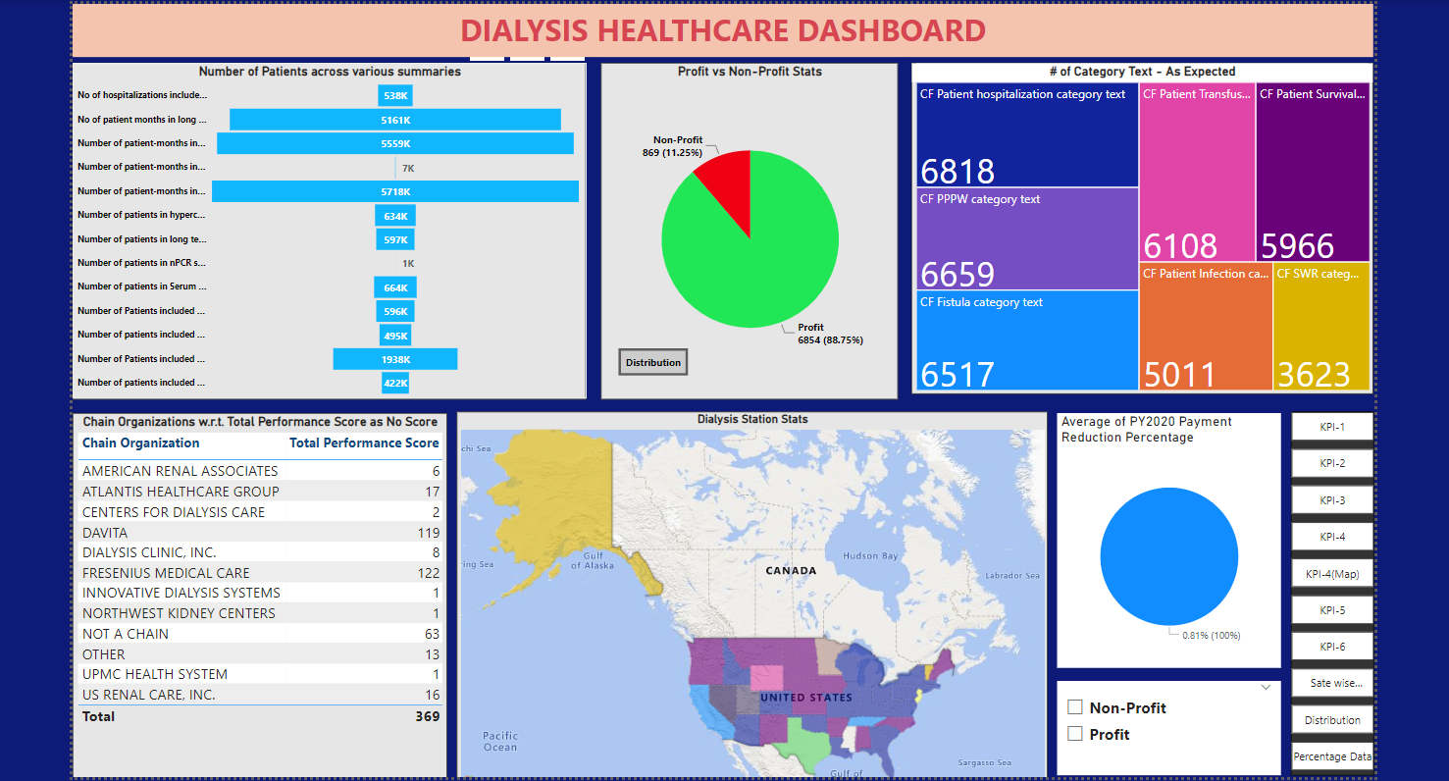
Power BI Dashboard

Slide 11
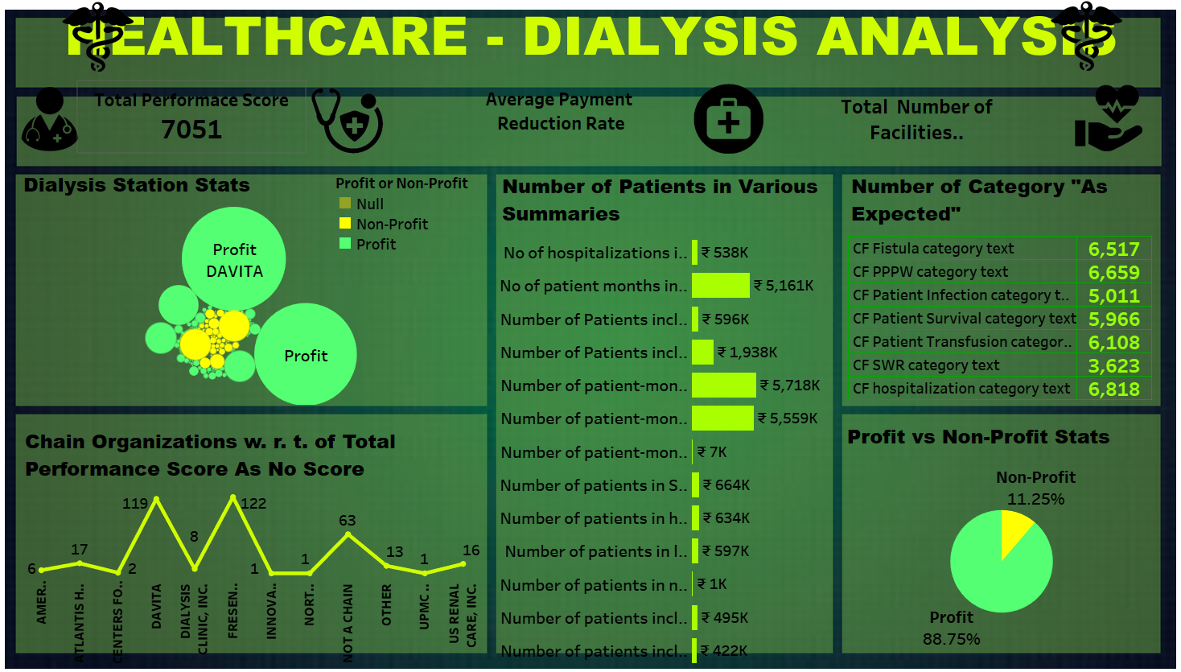
Tableau Dashboard

Slide 12
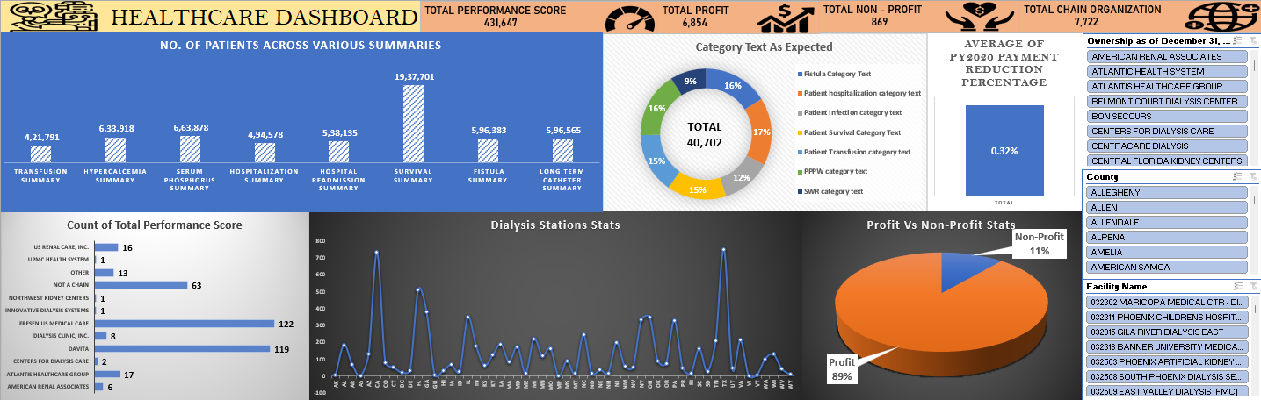
Excel Dashboard

Slide 13
Conclusion
In summary, the survival category has shown positive outcomes with the highest patient count, while the npcr summary has the lowest count.
Unfortunately, the count of profitable facilities decreased from 2018 to 2020, indicating a concerning trend. DAVITA and Fresenius Medical Care have a majority of profitable facilities.
Approximately 88.75% of facilities generate profit, while non-profit facilities require further analysis.
The highest performance score was recorded in 1969, while the lowest was in 1971.
Intermountain Healthcare and Memorial Hermann have high performance scores, while others need improvement.
The number of dialysis stations increased until 2018, but then started declining, which is also concerning.
To reduce costs, it is recommended to implement cost containment strategies such as improving operational efficiency and optimizing supply chain management.
Transitioning to value-based care models and leveraging technology and innovation can also optimize healthcare delivery and potentially reduce payments.
Quality improvement initiatives, such as reducing readmissions and preventing medical errors, can lead to cost savings and better payment rates.

Slide 14
Thank you

